Slide 1

Advanced Python Django
Generator, Threading, Pagination, Signals, Middleware & Caching
Program: EDGE-CSE CUET DIGITAL SKILLS TRAINING
Course: Python (Django) [Intermediate]
Lecture: Training Session-13 Date: 26th October, 2024 Duration: (1+1) hours
Instructor: Tanveer Rahman, Sr. Software Engineer, Friends Corp. Chuo-ku, Tokyo, JP shakil10vr@hotmail.com, 01626735005

Slide 2
Agenda
Generators:
Efficiently handle large datasets with lazy evaluation.
Threading:
Execute tasks concurrently within a single process.
Pagination:
Manage large datasets in APIs by dividing them into smaller, navigable chunks.
Signals:
Implement decoupled event-driven programming in Django.
Middleware:
Add custom functionality to the request/response lifecycle.
Caching:
Enhance performance by storing frequently accessed data.

Slide 3
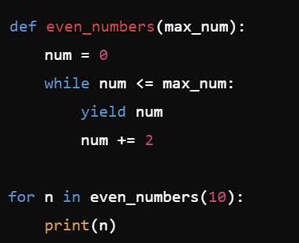
Generators in Python
Generators
Generators are a way to produce values lazily using the yield, next keyword.
Key Features:
Save memory by generating items on demand.
Used for large datasets or infinite sequences.
Example:

Slide 4
Task 1 – Generators (15 mins)
Create a generator function to yield Fibonacci numbers up to a given limit.

Slide 5
threading
Threading:
Allows different parts of a process to run concurrently. A thread is an independent unit of execution within a process.
Multi-processing:
Running multiple threads (lightweight subprocesses) within a single process. Use for I/O-bound tasks.
Multi-threading:
Python module: threading.
Running processes in parallel for CPU-bound tasks.
Python module: multiprocessing.

Slide 6
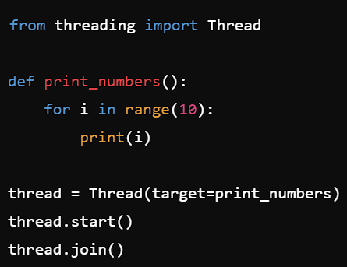
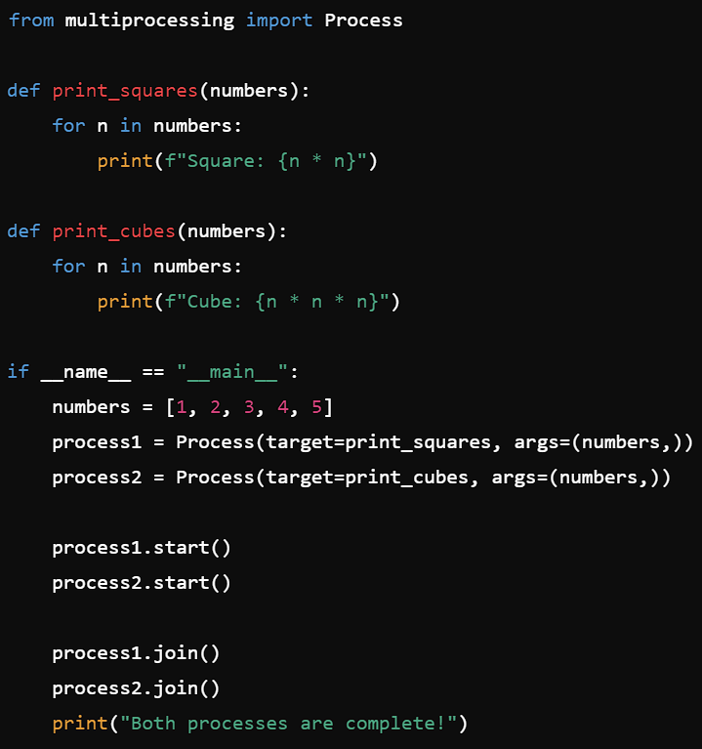
Multi-Threading/ Multi-Processing Example

Slide 7
Task 2 - Multi-threading / Multi-processing (20 Mins)
Write a Python program to calculate factorials of numbers in parallel using multi-threading.

Slide 8
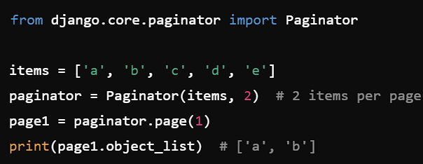
Django - Pagination
Purpose:
Example:
Divide content into pages for better UX.
Django's built-in Paginator class.

Slide 9
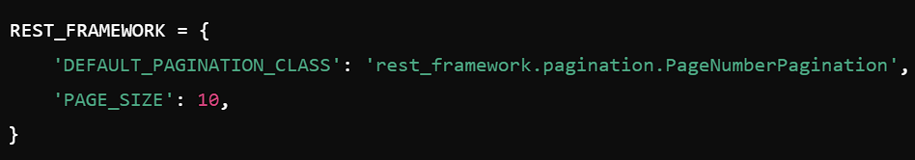
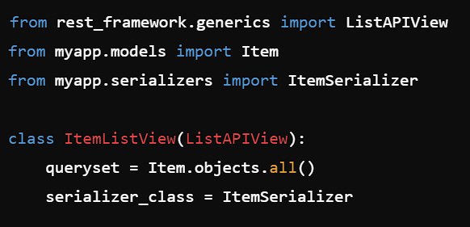
Adding Pagination to Django REST Framework
Define pagination in settings.py
In views.py

Slide 10
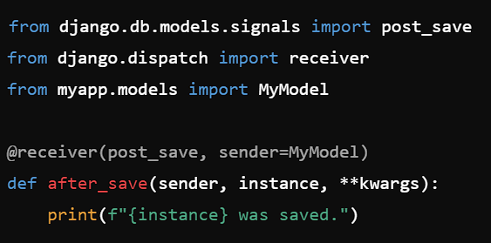
Django - SIGNALS
Example:
Built-in pub-sub system for event handling.
Signals:
Common signals: pre_save, post_save, pre_delete. post_delete

Slide 11
Task 3 - SIGNALs (30 mins)
Create a signal to generate a unique hex code while creating each book.

Slide 12
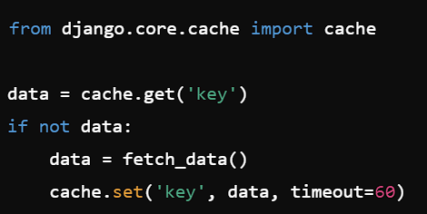
Django - CACHING
Caching Options:
Example (File Based Cache):
In-memory: Django's built-in cache.
External: Redis, Memcached.

Slide 13
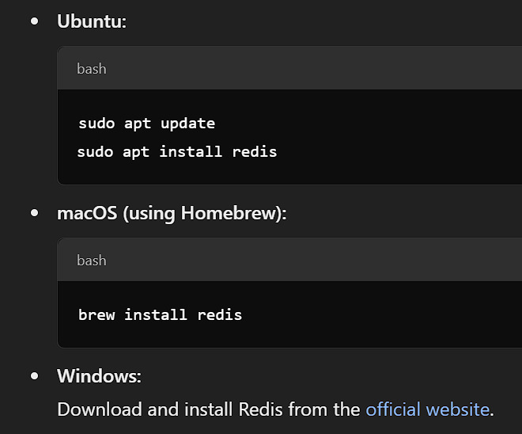
Django – CACHING (REDIS)
Install Redis
Verify Redis:
redis-cli
Ping
Install Redis in Django:
pip install redis django-redis

Slide 14
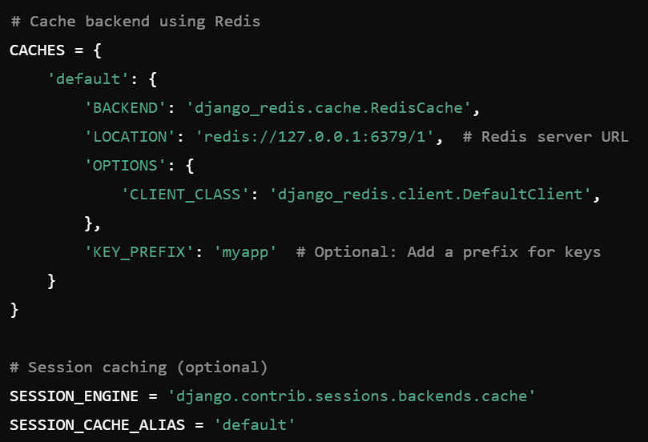
Django – CACHING (REDIS)
In settings.py

Slide 15
DJANGO-MIDDLEWARE
Hooks into Django's request-response lifecycle.
Example: Authentication, Security, or Custom Logging.

Slide 16
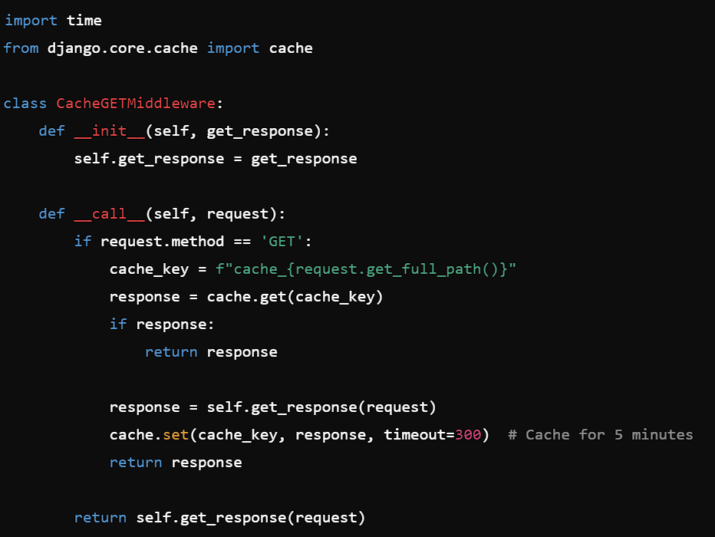
Custom Middleware for Caching
Purpose: Cache GET requests to reduce redundant database queries.
book > middleware.py

Slide 17
SETUP CUSTOM MIDDLEWARE
In settings.py
MIDDLEWARE = [
# Other middlewares...
‘book.middleware.CacheGETMiddleware’,
]
Test Middleware:
Make a GET request to an API endpoint.
Observe the cached response when the same URL is accessed within 5 minutes.

Slide 18

Q&A Session

